Slide 1
Logistic regression lab3
Eng: Samar Shaban

Slide 2
Problem: Recognizing cat pictures.
Algorithm: Logistic Regression with neural network mindset
Performance matrix: Accuracy

Slide 3
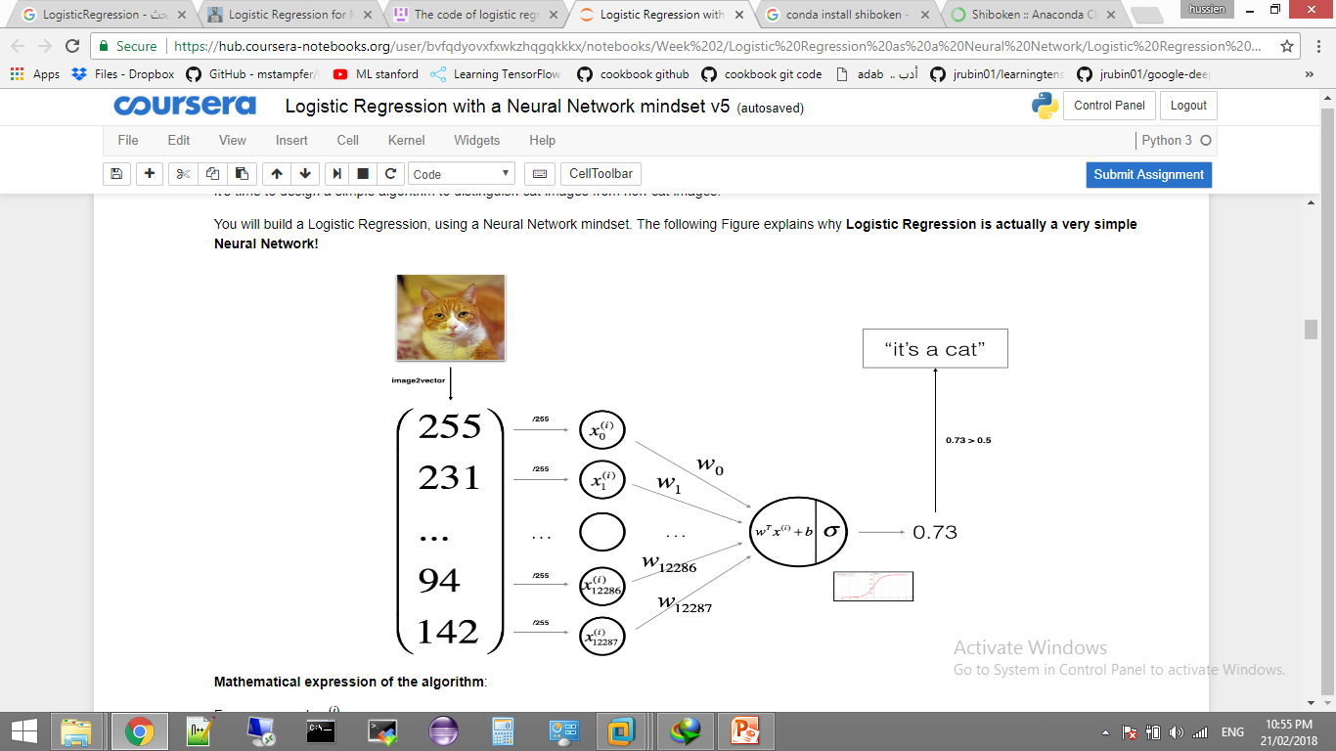

Slide 4
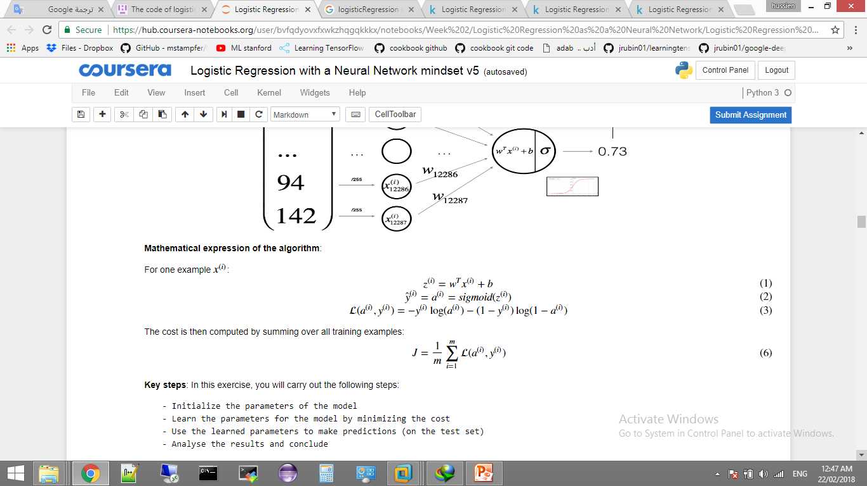

Slide 5
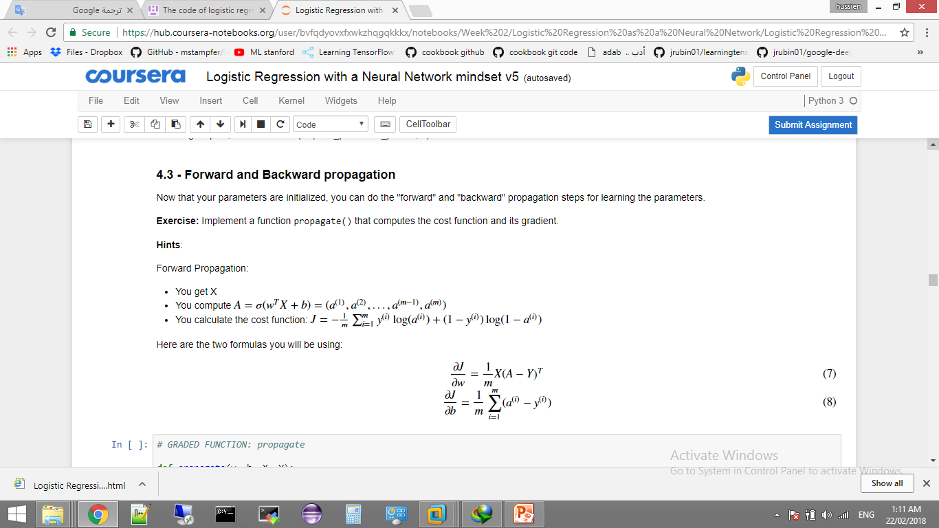

Slide 6
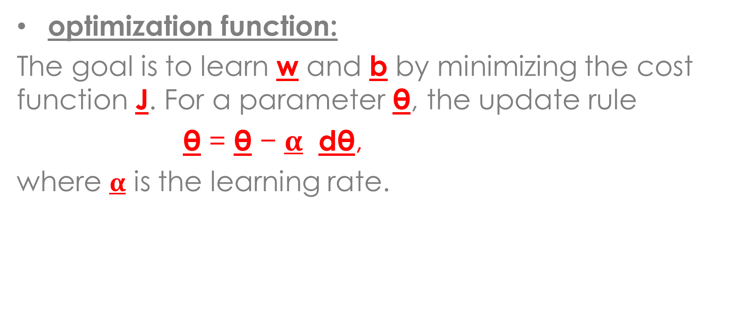
optimization function:
The goal is to learn w and b by minimizing the cost function J. For a parameter θ, the update rule
θ = θ − $α$ dθ,
where $α$ is the learning rate.

Slide 7
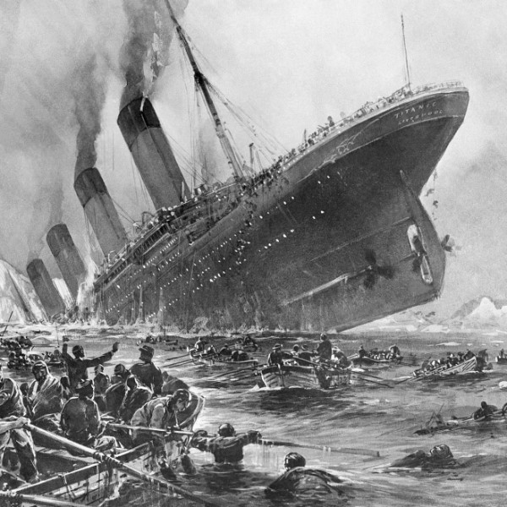
Implement :
Apply logistic regression
as explained on
Titanic Passengers Dataset.

